Slide 1
Global Superstore - Performance Analysis
Excel Data Analytics & PivotTable Project Dataset: Global Superstore
Submitted by: Yatika Goyal
Batch Code: 21-EXCEL-WD-0726-SA
Submitted to: Mr Sagar Submission Date: 17.08.2026

Slide 2
Objectives
This report uses Excel PivotTables and visualisations to compare the business performance of Global Superstore between 2013 and 2014.
Compare sales performance between 2013 and 2014.
Analyse the change in profit and determine whether profit grew at the same pace as sales.
Examine quarterly Sales and Profit trends to identify periods of stronger or weaker performance.
Evaluate customer segment and product category performance to identify major contributors to overall business results.
Identify key trends and areas requiring further management investigation and decision-making.
Analyse regional performance and identify regions contributing significantly to Sales and Profit.

Slide 3
Dataset Overview
Dataset contains the Global Superstore transactional dataset - approximately 51,290 records spanning multiple countries, product categories, customer segments, and financial metrics. Primary analysis focuses on 2013–2014; 2011–2012 serves as historical context only.
Key Data Fields
Primary Analysis Period
Time: Order Date , Year
Financial: Sales , Profit, Discount
Product: Category, Sub-Category
Geography: Regions, Country
Segment: Consumer, Corporate, Home office
2013 vs 2014
Secondary context: 2011–2012 only

Slide 4
Data Preparation & PivotTable Challenges
Several practical challenges were encountered while preparing the Excel data for PivotTable analysis. These are common in real-world datasets and must be resolved before reliable comparisons can be made.
Blank / Empty Entries
Field Consistency
Empty cells appear as (blank) categories in PivotTables, creating untidy or misleading summaries and charts.
PivotTables require consistent column headings and a clearly defined source range. Working and calculation areas must be separated from the core dataset.
Data Types
Date Handling & Filtering
Sales, Profit, Quantity, Discount, and Shipping Cost must be recognised as numerical fields so PivotTables correctly calculate sums and averages.
Order Date must be correctly recognised for yearly analysis. Consistent Year filtering is essential to ensure the 2013 vs 2014 comparison remains meaningful.
Data Clean → Transform→ Filter → Pivot → Compare → Interpret→ Visualisation

Slide 5
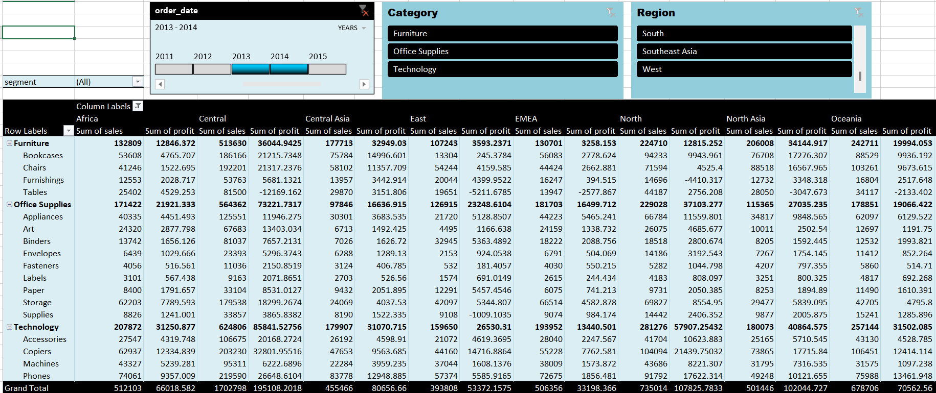

Slide 6
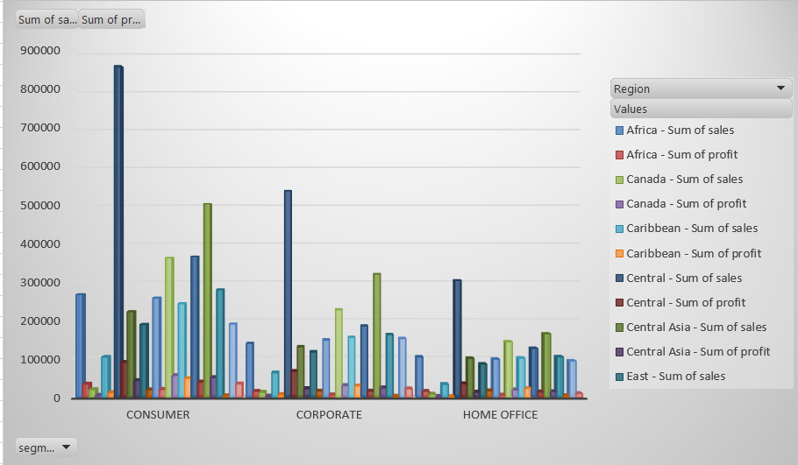

Slide 7
Regional Sales & Profit by Customer Segment
Explanation: This chart compares sales and profit across different regions and customer segments- Consumer, Corporate and Home Office. It provides an overview of how revenue and profitability are distributed across geographical and customer groups.
Analysis:
Consumer records the highest sales across several regions, indicating its significant contribution to overall revenue.
Corporate also shows strong sales performance across major regions.
Home Office generally contributes less sales compared with Consumer and Corporate.
Key Observation: Consumer is the dominant segment in terms of sales, but strong sales do not necessarily result in proportionately high profit. Therefore, both regional and segment-level profitability should be considered when evaluating business performance.

Slide 8
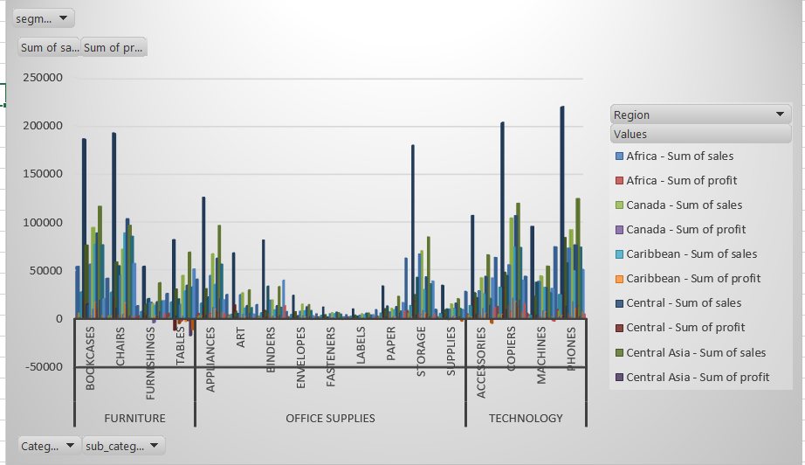

Slide 9
Product Category & Regional Sales/Profit Analysis
Explanation: This chart compares sales and profit across sub-categories within Furniture, Office Supplies and Technology, while also showing their distribution across different regions.
Analysis:
Technology shows strong sales performance, particularly across major regions.
Within Furniture, Chairs and Bookcases are among the stronger sales contributors.
In Office Supplies, Storage, Binders and Paper show notable sales activity.
Technology sub-categories such as Phones, Copiers and Accessories contribute significantly to sales.
Profit is considerably smaller than sales across the sub-categories, indicating that high sales volume does not necessarily result in proportionately high profit.
Key Observation: Technology contains several of the strongest-performing sub-categories by sales, while performance varies considerably across regions and products. This highlights the importance of analysing both product-level sales and profitability when assessing overall performance.

Slide 10
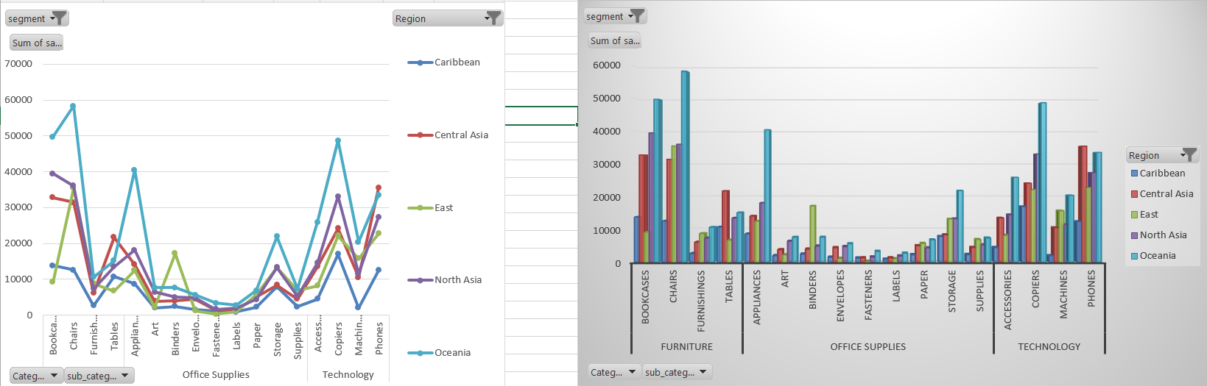
Sales Trend Across Sub-Categories by Region
Sales fluctuate considerably across sub-categories, with noticeable peaks in Chairs, Appliances, Storage, Copiers and Phones. Oceania shows particularly strong peaks in several sub-categories, indicating significant variation in regional sales performance.

Slide 11
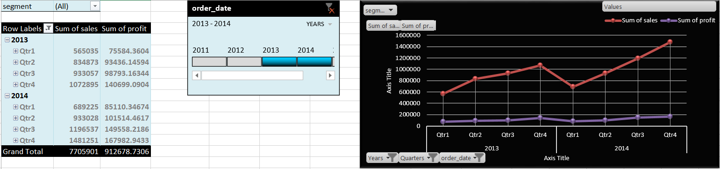

Slide 12
Quarterly Sales & Profit Trend - 2013 vs 2014
Explanation: This chart compares quarter-wise Sales and Profit for 2013 and 2014, helping assess how business performance changed throughout each year.
Analysis:
In 2013, sales increased steadily from Q1 to Q4, while profit also showed an overall upward movement.
In 2014, sales followed a similar upward pattern, with a noticeable increase in Q3 and the highest sales in Q4.
Profit also increased in 2014, with the strongest profit recorded in Q4.
The quarterly pattern shows some fluctuations, particularly between Q1 and Q2, but the overall direction remains positive.
Key Observation: 2014 outperformed 2013 in both Sales and Profit across every quarter. The strongest year-on-year improvement is visible in Q3 and Q4, with Q4 recording the highest Sales and Profit in both years.

Slide 13
References
https://www.kaggle.com/ → Global Superstore Dataset
Tool Used
Microsoft Excel → Pivot Tables & Pivot Charts

